Slide 1
Medical Emergencies
A Few Notes on How to Respond

Slide 2
What will we cover today…?
Brief overview of:
Seizure 1st Aid
How to recognize a Heart Attack
Calling 9-1-1

Slide 3
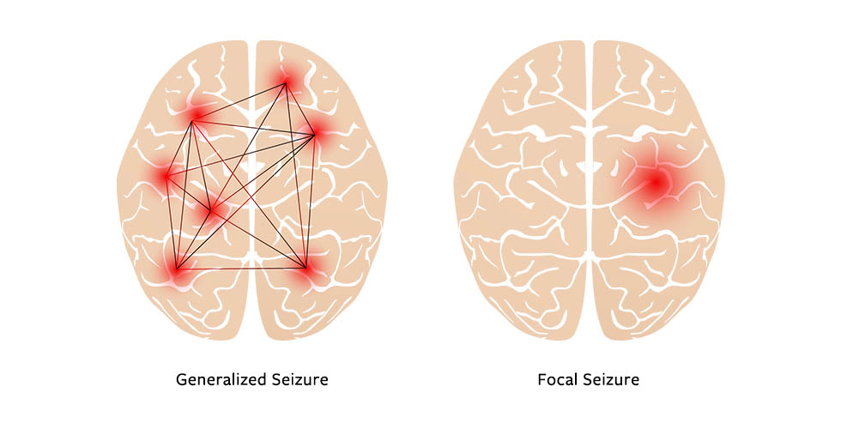
Seizure

Slide 4
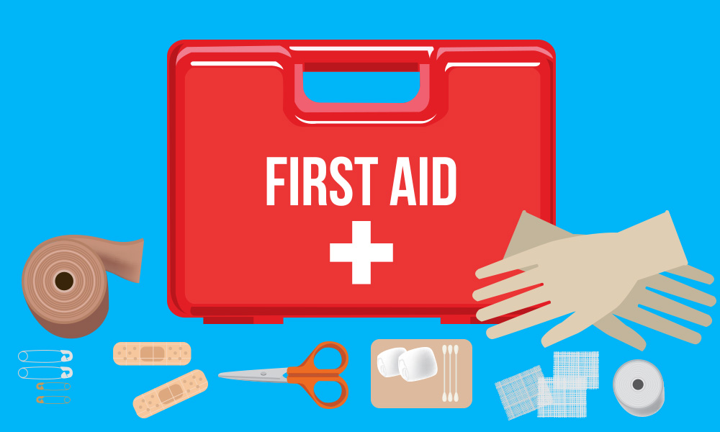
Seizure: First Aid
Prevent injury
Move items out of the way
Put pillow under the head
Turn patient to side – if possible – to prevent aspiration
Observe seizure: measure duration & type of symptoms
Post seizure:
Keep airway patent – suction secretions if necessary
Turn patient to side if not already there
Initiate rescue breathing or CPR if necessary (rare)
DO NOT:
Restrain the person
Put items in their mouth
Stand and gawk
DO:
Call 9-1-1 if seizure lasts more than 5 minutes

Slide 5
Knowledge Check
Q: Your colleague with a history of seizures reports experiencing an aura. A moment later, they begin to seize. What do you do? Select all that apply.
1. Protect them from injury during the seizure (move furniture out of the way, pillow under the head).
2. Call your friends to come watch.
3. Start tracking the length of time the seizure lasts.
4. Turn them on their left side to recover.
5. Hold them down so they don’t hit themselves.
A: 1, 3, and 4

Slide 6
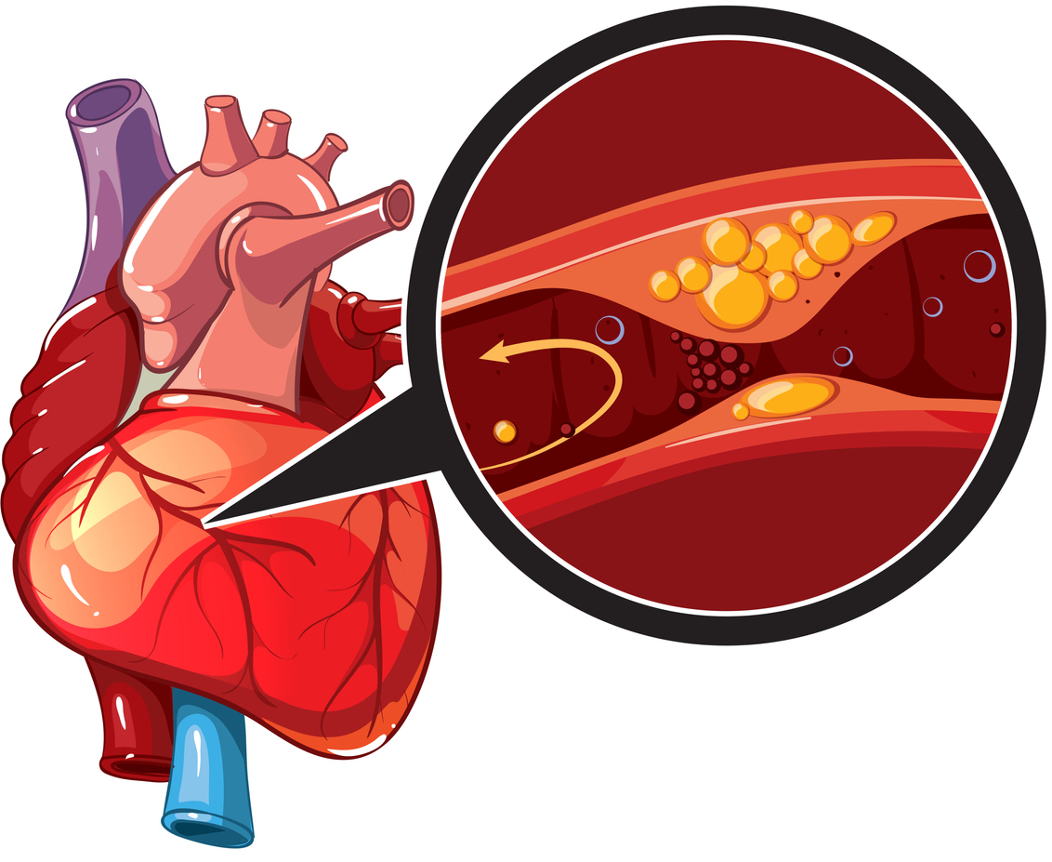
Heart Attack (aka myocardial infarction, or MI)

Slide 7
Signs & Symptoms: Women
Commonly different than what is shown in movies…
Shortness of breath
Stomach issues: nausea, heartburn, indigestion, pain
Extreme fatigue
Upper back pain
Heart disease kills more women over the age of 65 than all cancers combined

Slide 8
Signs & Symptoms: Men
“Classic” symptoms:
Pain radiates to left arm and/or jaw
Chest pain described as crushing and heavy
Feeling of “impending doom”
Pale skin
Cold sweat
Dizziness

Slide 9
Heart Attack: First Aid
Call 9-1-1
DO:
Send someone to get an Automated External Defibrillator (AED)
If person is conscious, give chewable aspirin (324mg)
If pulse is lost, start CPR
DO NOT:
Dither about
Believe them if they say they are “OK”

Slide 10
Knowledge Check
Q: TRUE or FALSE
Men and women tend to experience the same symptoms when they have a heart attack.
A: FALSE
Q: TRUE or FALSE
There are two AEDs on campus. One in the Administration building, and one in the Gym.
A: TRUE

Slide 11
Calling 9-1-1

Slide 12
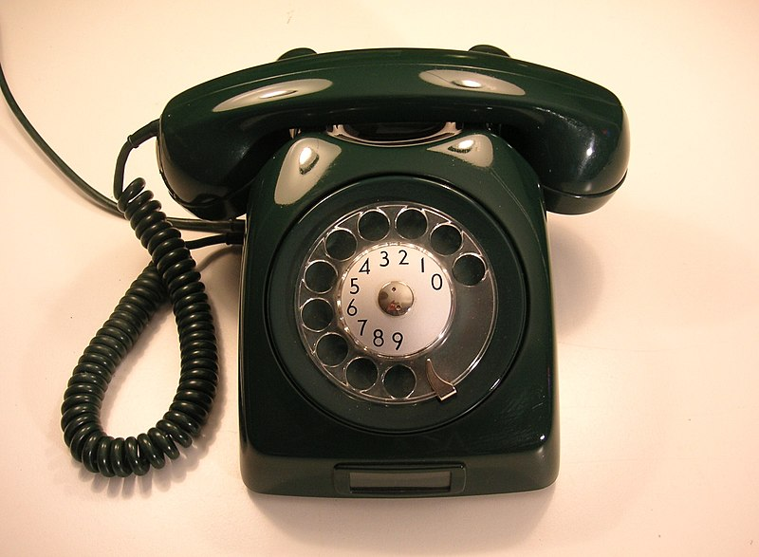
Tips for Calling 9-1-1
Be prepared with basic information about the event:
Location: Where are you and what is the address?
Do not assume the dispatcher knows Plumas County
Your phone number
The type of emergency: Fire, bomb threat, heart attack, etc.
Details about the emergency: Be as factual as possible

Slide 13
Knowledge Check
Q: You are interested in learning more about first aid and how to do CPR. What is/are the best course(s) of action? Select all that apply.
1. Do nothing. You’ll figure it out when/if something happens.
2. Put your name on the “Sign-Up” sheet in the back of the classroom to
be notified of the next Heartsaver 1st Aid/CPR/AED class (CPR 080).
3. Call Nancy Moore at x328 and let her know you want to take her class.
4. Find a YouTube video and teach yourself how to do CPR.
5. Commit to the whole enchilada and sign up for the CPR class for
healthcare professionals (CPR 001), scheduled for Tues. 8/29 at 5pm.
A: 2, 3, and 5

