Slide 1
Student Success Data II
Disaggregated by Delivery Mode, Ethnicity, and Special Populations

Slide 2
Course success data may be obtained either from Banner or from the Chancellor’s Office, and the two are not completely identical.
Yet first a glimpse at the diversity of FRC:

Slide 3
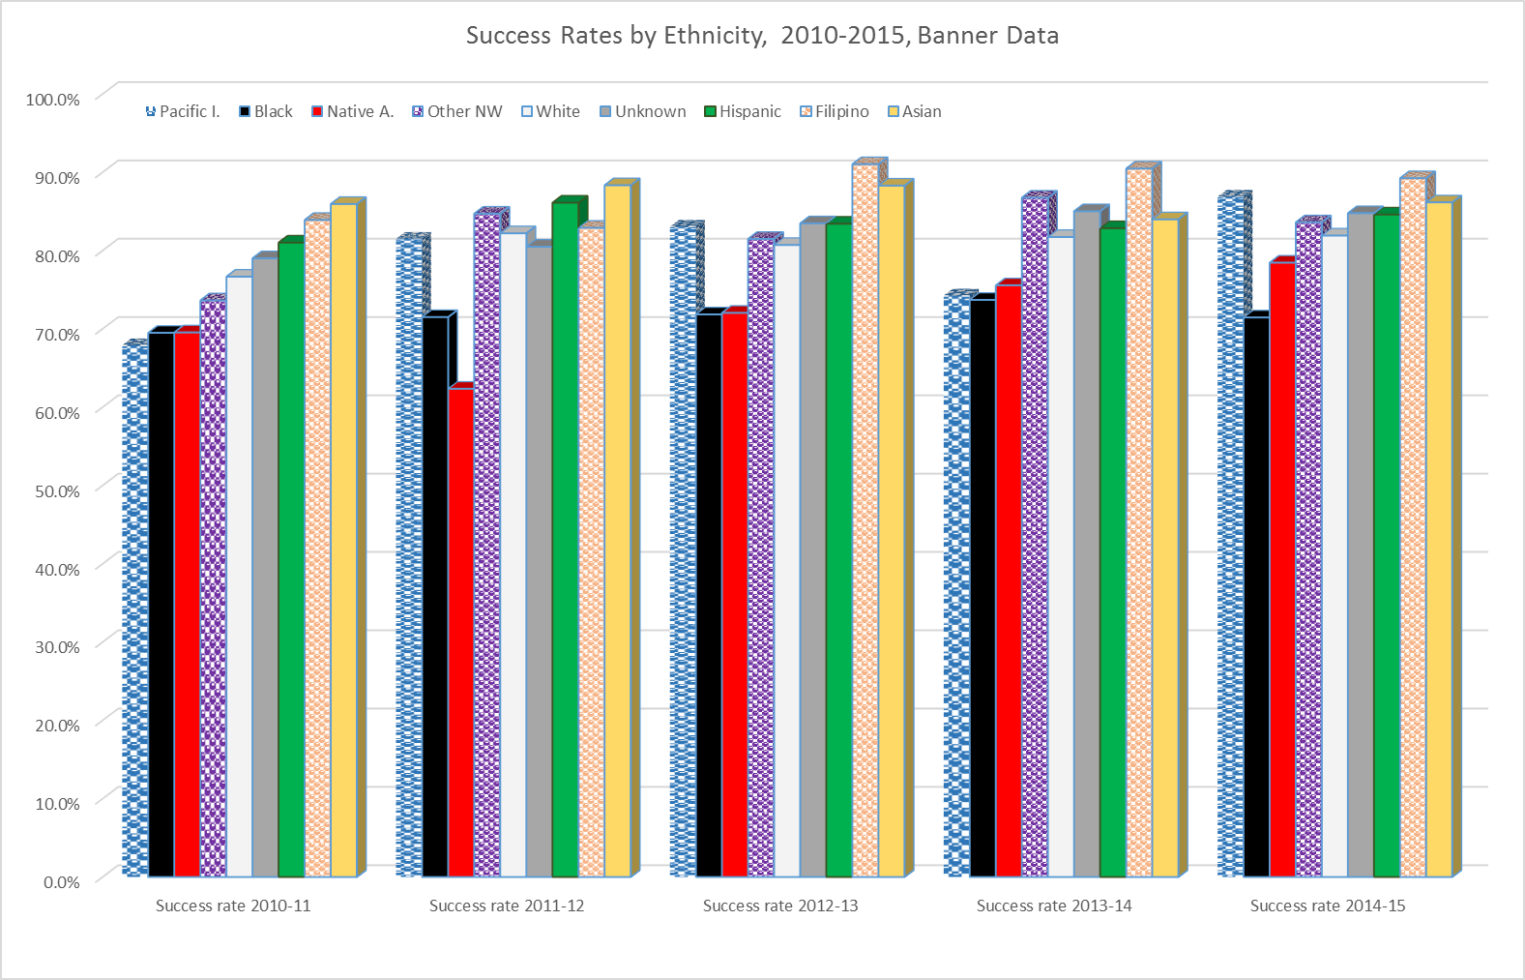
Consistently above average are the Asians, Filipinos, Hispanics and Whites (in decreasing order). Consistently below average are the Native Americans and Blacks.

Slide 6
The CCCCO Data distinguishes between credit, basic skill, vocational etc. courses, and does not have a Filipino group – yet consistently above average are the Asians, Hispanics and Whites, and consistently below average are the Native Americans and Blacks, here too

Slide 7
From the point of view of not allowing for significant disproportionate effect, FRC in general does decent in the long run – yet there are programs/ subjects where disproportionate effect happens

Slide 8
In two slides, programs are grouped according to their student success rates – as compared to the average performance of the groups at FRC
Note: empty cells are for cohorts smaller than 11 (some 0, indeed)

Slide 10
By applying the 80-percent rule to programs, we may identify those in need of special efforts to improve the results of vulnerable groups

Slide 12
Finally, some aggregated data on special populations – their numbers do not allow for by-program analysis, or, respectively, the incarcerated students’ performance by subject has been reviewed at “delivery mode”

Slide 13
THANK YOU!

