Slide 1
Student Success Data I
Disaggregated by Delivery Mode, Ethnicity, and Special Populations

Slide 2
Overall course completion rates are around 84%. Failing rates are at 16%, and there are 5% of D-s (D+ and D), which gives a success rate of 79-80%, discounting the incompletes.

Slide 3
Yet these success rates do not apply to all courses, programs, or departments alike. The chart gives a hint about their variation (only subjects taught in both two main terms of AY 2014-2015 are included)

Slide 4
Subjects & programs show quite a variation in their results disaggregated along delivery mode and student groups. General image: distance education is VERY disadvantaged!

Slide 5
Some programs do not have DE at all, yet have good results with the incarcerated students

Slide 6
Some other subjects also happen to favor DE

Slide 8
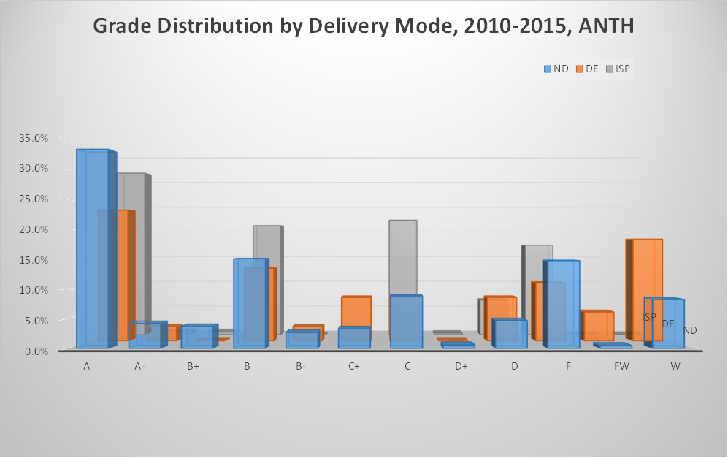
In case of five subjects, there is some slighter, yet persistent disadvantage of DE and ISP. “Slighter” is meant as compared to the next four subjects (BIOL, BUS, ECE, HIST)

Slide 11
Last, but not least, there are three subjects where DE is so disproportionately disadvantaged that we may wonder why do some students keep enrolling in them:

Slide 12
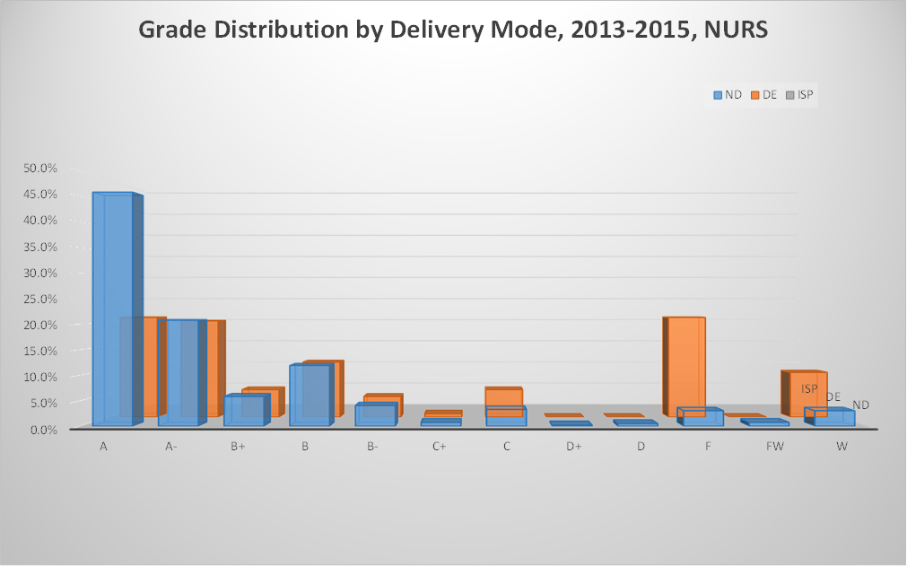
-- End of disaggregation by delivery mode --

