Slide 1

Student Athlete Profile
Presented by Merle Trueblood
November 2016

Slide 2
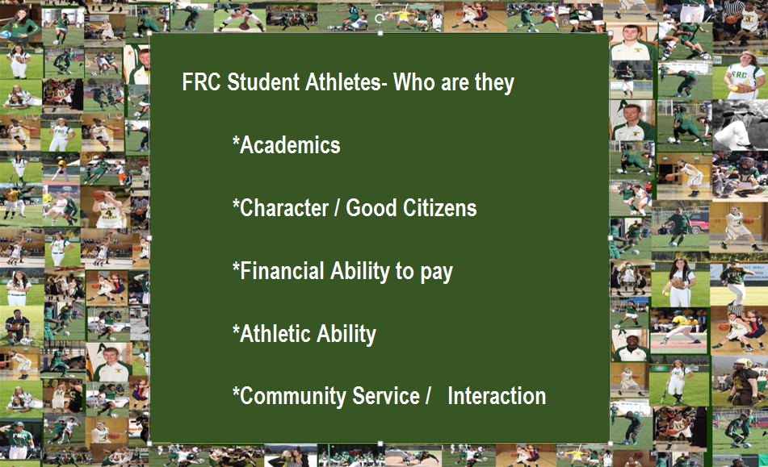
FRC athletes – Who are they

Slide 3
Student Athletes- Eligibility
Enrolled in a minimum of 12 units (9 academic units)
Weekly 12 unit enrollment checks
Minimum 2.o GPA
Progress reports 5th and 11th week
Mandatory study hall
Mandatory SEP before participation
Athletic Advisor – Greg McCarthy
Need to take 12 units of General Ed classes each Semester to graduate.

Slide 4
Student Athletes – Headcount academic year comparison
* Athletes include all students who have participated in sports, tagged as such in Banner for at least one term of the AY.
Note: Definition of ‘full time student’ was changed in 2015, now requiring >=525hrs attended.

Slide 5
Student Athletes – Workload academic year comparison
Source: Banner
Note: All FRC FTES may be different from that reported to state of CA. Summer courses were not shifted and excluded students were included in these figures. Both credit and non-credit attempted hours are included.

Slide 6
Student Athletes – Revenue academic year comparison
Source: Banner and CCCCO
Note: Apportionment uses marginal FTES $’s ($4,676 for credit, $2,812 for non-credit). Applies academic year to fiscal year and therefore provides an estimate. Out-of-state fees were $6030/FTES in AY 2015-16. In-state fees are not considered a revenue.

Slide 7
Headcount by Sport
Source: Banner.
Note1: There are students who compete in more than one sport. In AY 2015-16 there were 15.
Note2: Years 2010-2011 through 2013-2014 include only those athletes who were registered in the fall or spring term. AY 2014-15 and 2015-16 include all active athletes tagged as such in Banner for any term of the AY.

Slide 8
GPA by Sport by academic year
Source: Banner
Athletes include students in competition during the year; GPA is the year-end GPA earned for all courses (cumulative GPA)

Slide 9
Success Beyond FRC scholarships and transfers
363 scholarships
$10,277,903 million in $
20 Athletes turned pro in 2011-15 for $1.895 million.
Sport | Scholarship Recipients |  |  |  |  | Amount
 | 2010-11 | 2011-12 | 2012-13 | 2013 -14 | 2014-15 | 2010-11 | 2011-12 | 2012-13 | 2013-14 | 2014-15
Baseball | 14 | 12 | 14 | 12 | 16 | $569,000 | $423,375 | $397,300 | $319,743 | $414,570
Football | 17 | 14 | 13 | 17 | 11 | $774,000 | $713,600 | $725,430 | $825,000 | $284,385
Men's Basketball | 3 | 1 | 2 | 3 | 2 | $164,000 | $80,000 | $130,000 | $59,000 | $52,000
Men's Soccer | 1 | 4 | 2 | 8 | 7 | $24,000 | $304,000 | $32,000 | $213,000 | $242,000
Rodeo | 21 | 16 | 25 | 17 |  | $257,500 | $286,500 | $312,000 | $187,000
Softball | 9 | 3 | 11 | 2 | 0 | $224,000 | $134,000 | $215,500 | $40,000 | $0
Volleyball | 5 | 6 | 7 | 3 | 6 | $131,000 | $190,000 | $280,000 | $102,000 | $225,000
Womens B-Ball | 2 | 3 | 0 | 0 | 2 | $80,000 | $80,000 | $0 | $0 | $60,000
Women's Soccer | 2 | 0 | 6 | 4 | 8 | $48,000 | $0 | $134,000 | $160,000 | $317,000
Total | 74 | 59 | 80 | 66 |  | 2,271,500 | 2,211,475 | 2,226,230 | $1,905,743 | $1,662,955

Slide 10
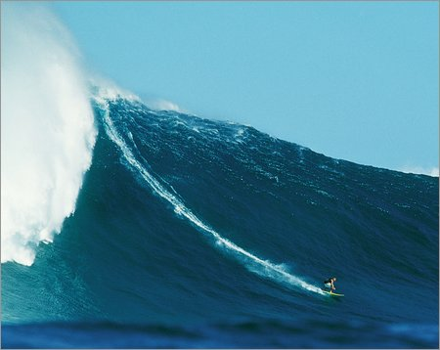
The Next Wave
HES/Athletics Proposal – Adding of sports
Continued Title IX Compliance – Prong 2
CCCAA Cost containment – Increase # games
Gym remodel – Sprung
Boosters & Varsity Clubs
Facilities building weights
HES Academic Courses
Concussion Monitoring
Future Housing needs
Retaining Quality coaches

Slide 11
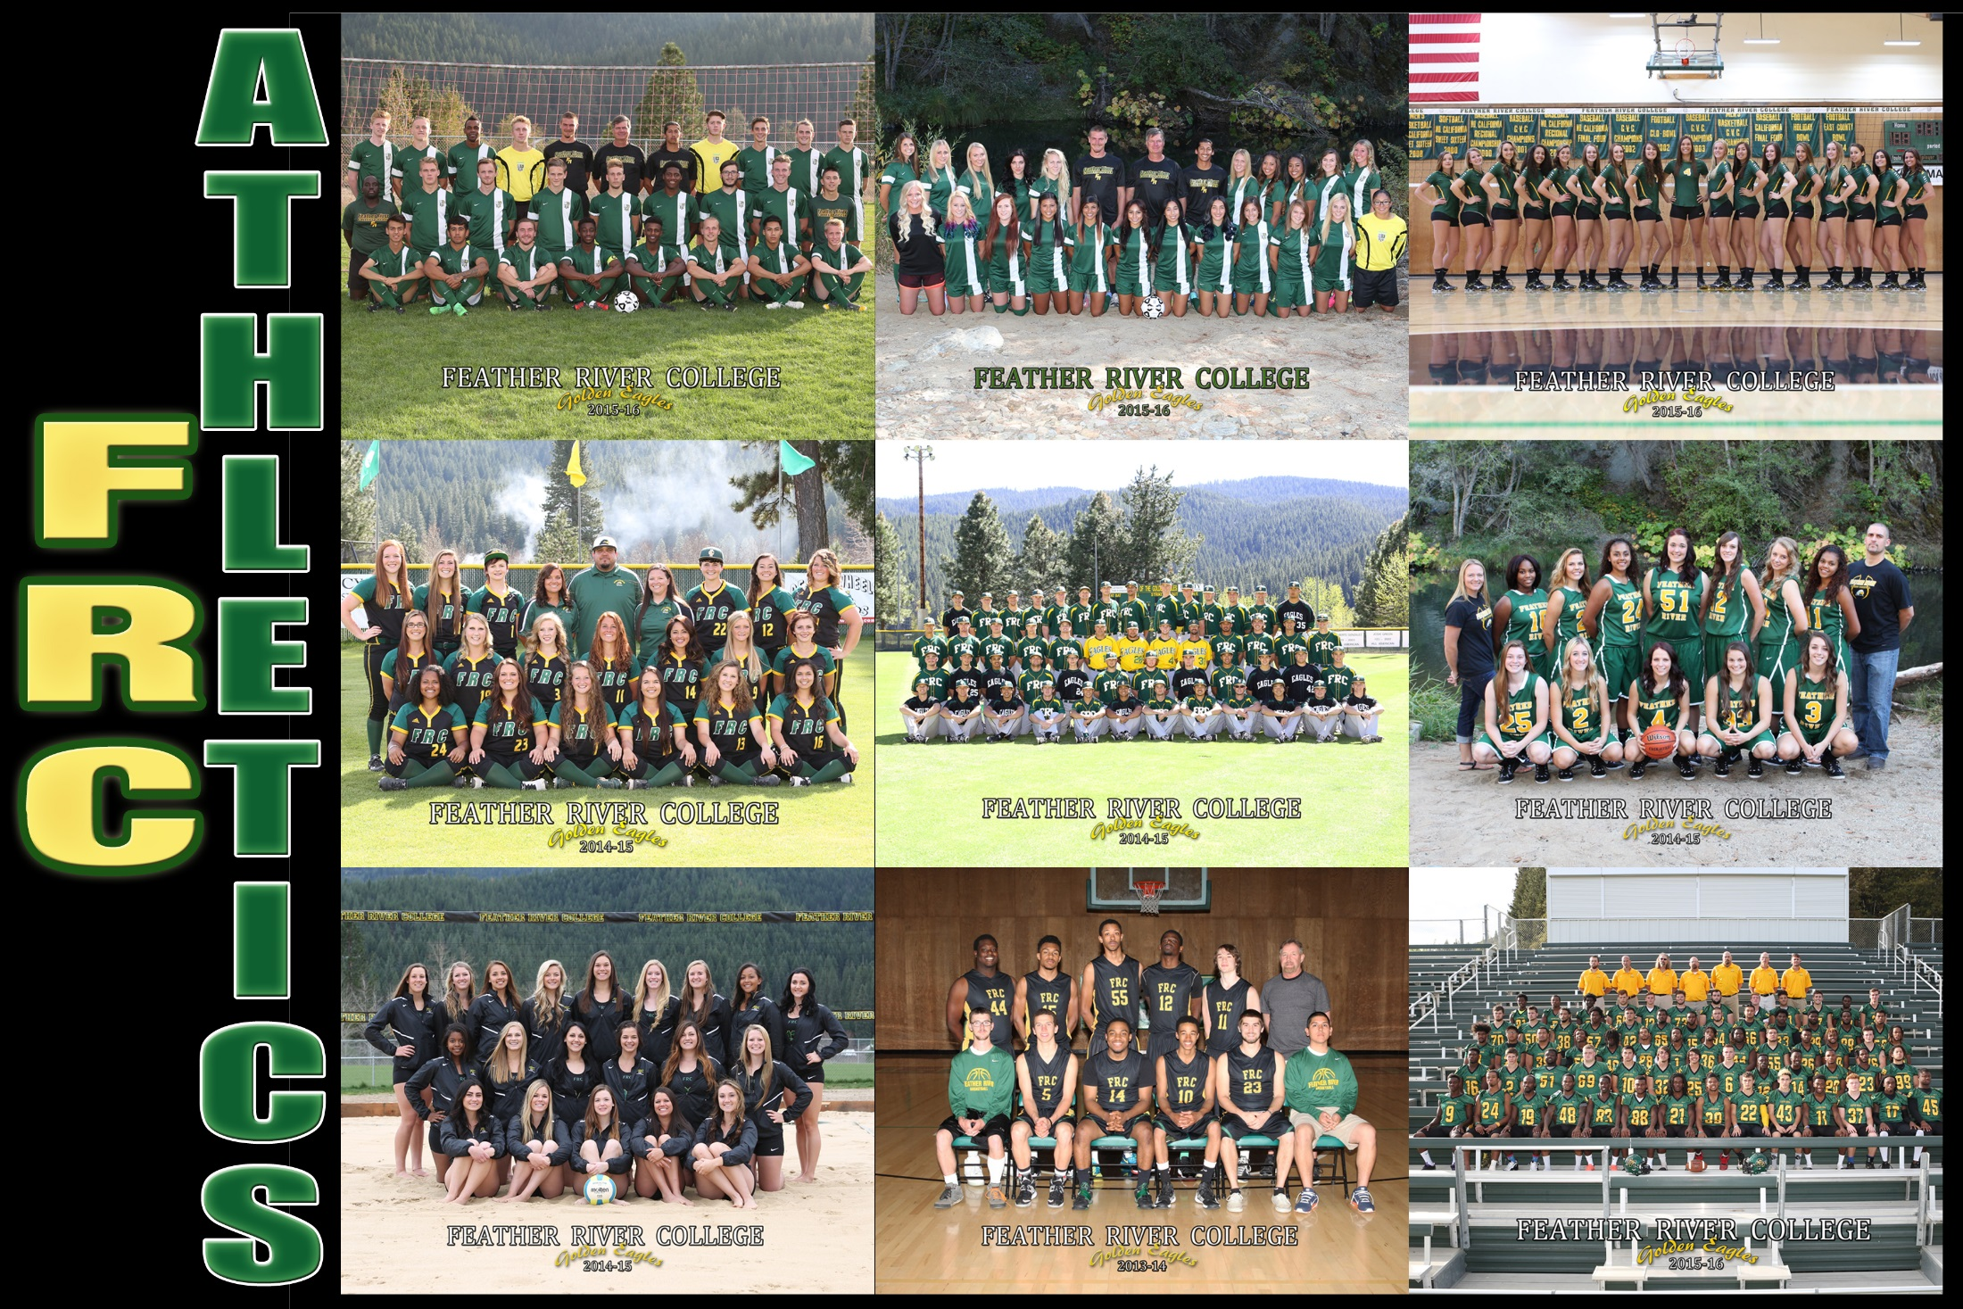
THANK YOU!!!
Questions / Comments

