Slide 1
CREATING A JOB REQUISITION

Slide 2
So you want to create a Requisition? You have already notified the Human Resources Department that you are planning to create/fill a job opening, correct? You will need to log in to https://frc.hiretouch.com/admin website. If you have already been assigned a log in and password, please enter them here. If you have not previously been given access to the Hiretouch website you should be receiving an email that looks like:
It will say:

Slide 3
You can click on the link to log in. Your username will be your email address. Copy and paste the provided password into the log in page.
This is the first page you see. You will be able to create your permanent password here. Don’t forget to write it down somewhere so you can have it for future use.

Slide 4
The next thing you see is your home page (see example below). If you have an active job opening you need to review it will show up under “My Active Jobs”. If you have a req to approve it will be under (yep, you guessed it) “My Reqs to Approve”. The client notifications box is for messages from the Hiretouch Company to it’s users. If you need to disable that box you can use the “Display Preferences” Button to change your home screen.

Slide 5
To begin a new Requisition, click on the “Jobs” tab.
In the “Jobs” tab you will see any jobs that are in a “posted” or “closed” status that have been assigned to you. To start a new requisition, click on the “add a requisition” button.

Slide 6
Add a Requisition: Step 1 Choose a template. If you do not see a template that fits the position you are requesting, or if you are not sure which template your position belongs in, please call HR for guidance. Once you have chosen a template, be sure you hit the continue button, or you will not be able to move forward.

Slide 7
Add a Requisition: Step 2 On this page you will change the Title to whatever position you are requesting. Then hit continue. DO NOT CHANGE ANYTHING ELSE ON THIS PAGE!

Slide 8
Add a Requisition: Step 3
This page should be auto populated and all you need to do is hit continue.
Add a Requisition: Step 4
The following pages will now be labeled with the job title. Click on the start button. You will now be able to exit and return later to finish if needed.

Slide 9
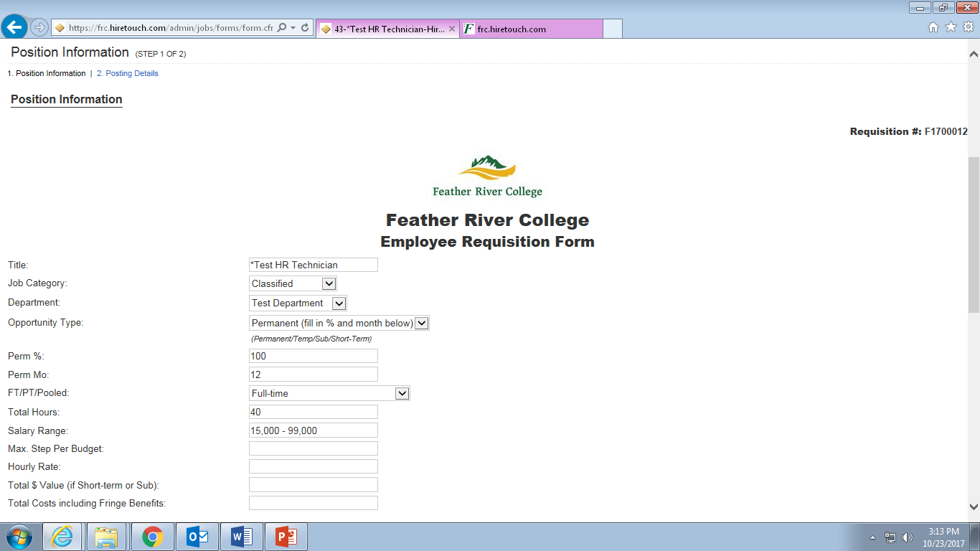
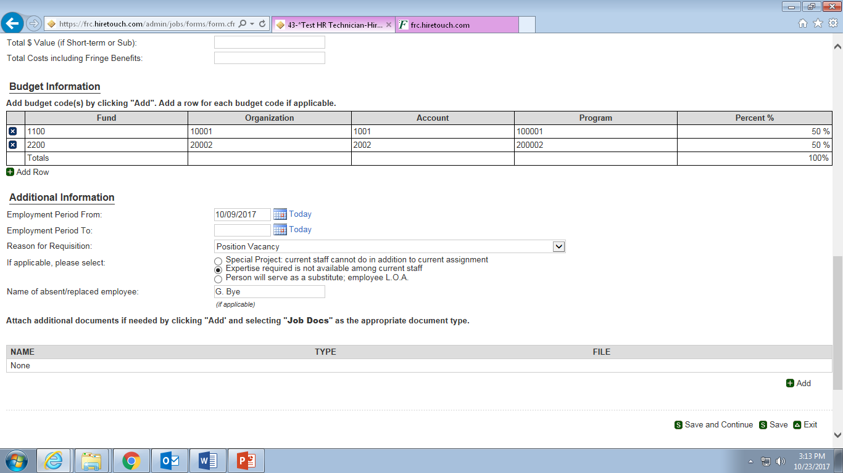
Add a Requisition: Step 5
Please fill out the form as completely as you possibly can. Here are some directions:
Title: This should be auto filled.
Job Category: Choose a category from the drop down box.
Department: Choose a department from the drop down box. If you cannot find your department listed, please contact HR.
Opportunity: Please choose category from the drop down box.
Perm %: If the position is permanent, please enter expected %.
Perm Mo: If the position is permanent, please enter the expected month per year of work.
FT/PT/Pooled:Please choose a category from the drop down box.
Total Hours: Please enter expected hours to be worked.
Salary Range: Please enter the salary range from the salary schedule applicable to this position. If this position does not fall into a specified salary schedule, leave the box blank.
Max Step
per Budget: Leave this box blank.
Hourly Rate: If your position does not fall within the salary range, please list hourly rate here.
Total $ Value: Please enter total $ value (for short-term and substitute employees). IF you are unsure, leave blank.
Total Cost: Please enter total position cost including all fringe benefits.
You are required to enter the budget code information (Don’t forget the %). You can add additional rows for budget codes by hitting the “add a row” button.
Employment
period from: Choose the requested start date from the calendar.
Employment
period to: Choose the requested end date from the calendar. If you do not have an end date, leave blank.
Please choose applicable categories for the reason for this requisition.
Do not do anything with the “Attach additional documentation box”
Click on the “Save and Continue” button.

Slide 10
Add a Requisition: Step 6
Select your name from the drop down box for Supervisors.
Below that, there is a comments box. You can put any suggestions for changes to the job description, or any suggestions of places to advertise.
Now look at the committee members box. This is where you can list suggested members for this search committee. Just click the “add a row” button if you have more than one suggestion. If you do not have any, leave blank. (note: suggested committee members are not guaranteed).
Supervisor request and certification: Please choose todays date from the calendar and enter your name in the text box. Then hit the “Continue to Approvals” button

Slide 11
Congratulations!
You have now completed you Employee Requisition Form through our new system.
But wait…………………..What if I don’t have time to finish my Req right now?
If you need to exit Hiretouch before finishing, you can do so. When you log back in go to the “Jobs” tab and choose the job you are working on. Then on the green tabs, choose the “Forms” tab, and finally click on “continue”. This will bring you back to your last saved point on the requisition.
Add a Requisition: Step 7
On this page you will select approver from the drop down box provided. Always choose:
Human Resources: Group Approval
Next hit the “Save and Send” button.

